Slide 1


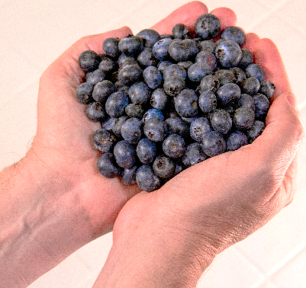



Human Nutrition Research Study – We Need Your Help
Blueberry
Absorption
Metabolism
A research study investigating the nutritional equivalence of fresh and processed berries
Interested in helping?
Call (704) 250-5451 or email blueberrystudy@ncsu.edu
Can you participate?
What will you be asked to do?
Participants may receive
You can help us if you are
25-65 years old,
non-smoker (or ex-smokers who ceased ≥ 6 months ago),
generally healthy and without chronic diseases,
have no allergies to salicylates, dairy products, specifically whey protein, or berries,
have healthy body weight, BMI* from 18.5 to 30 (lbs/inches²x703).
*BMI: Body Mass Index
Come to the Human Research Core (NCRC; Kannapolis, NC) for consent and screening visits;
Consume over 4 study days:
  1 cup or 150 g of blueberries,
  1 cup or 150 g of a different blueberry variety,
  A protein bar containing blueberries,
  A control matched for blueberry nutrients
Provide blood and urine samples;
Study duration: 4 days plus 8 one-hour visits over a 3-month period (54.5 hours total)
Compensation for the procedures you undergo
Travel expense reimbursement, subject to the trip distance to the North Carolina Research Campus

